Slide 1
Sequences and Summations
Computer Science, Purdue University
Copyright McGraw Hill, Rosen, Discrete Mathematics and its Applications

Slide 2
Sequences and Summations
Sequences: Some Examples
Example: Suppose that a person deposits $10,000.00 in a savings account at a bank yielding 11% per year with interest compounded annually. How much will be in the account after 30 years?
Let P_{n} denote the amount in the account after 30 years. P_{n} satisfies the following recurrence relation:
P_{n} = P_{n-1} + 0.11P_{n-1} = (1.11) P_{n-1}
with the initial condition P₀ = 10,000
Computer Science, Purdue University

Slide 3
Sequences and Summations
Sequences: Some Examples
P_{n} = P_{n-1} + 0.11P_{n-1} = (1.11) P_{n-1}
with the initial condition P₀ = 10,000
Solution: Forward Substitution
P₁ = (1.11)P₀
P₂ = (1.11)P₁ = (1.11)²P₀
P₃ = (1.11)P₂ = (1.11)³P₀
:
P_{n} = (1.11)P_{n-1} = (1.11)^{n}P₀ = (1.11)^{n} 10,000
P_{n} = (1.11)^{n} 10,000
P₃₀ = (1.11)³⁰ 10,000 = $228,992.97
Computer Science, Purdue University

Slide 4
Sequences and Summations
Sequences: Some Examples
Given a few terms of a sequence, try to identify the sequence. Conjecture a formula, recurrence relation, or some other rule.
Some questions to ask?
Are there repeated terms of the same value?
Can you obtain a term from the previous term by adding an amount or multiplying by an amount?
Can you obtain a term by combining the previous terms in some way?
Are they cycles among the terms?
Do the terms match those of a well known sequence?
Computer Science, Purdue University

Slide 5
Sequences and Summations
Special Integer Sequences
Example 1: Find formulae for the sequences with the following first five terms: 1, ½, ¼, 1/8, 1/16
Solution: Note that the denominators are powers of 2. The sequence with a_{n} = 1/2^{n} is a possible match. This is a geometric progression with a = 1 and r = ½.
Example 2: Consider 1,3,5,7,9
Solution: Note that each term is obtained by adding 2 to the previous term. A possible formula is a_{n} = 2n + 1. This is an arithmetic progression with a =1 and d = 2.
Example 3: 1, -1, 1, -1,1
Solution: The terms alternate between 1 and -1. A possible sequence is a_{n} = (−1)^{n} . This is a geometric progression with a = 1 and r = −1.
Computer Science, Purdue University

Slide 6
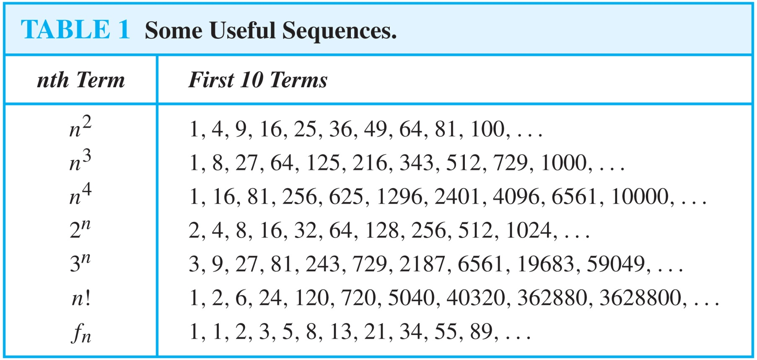
Sequences and Summations
Common Sequences
Computer Science, Purdue University

Slide 7
Sequences and Summations
Inferring Sequences
Example: Conjecture a simple formula for a_{n} if the first 10 terms of the sequence {a_{n}} are 1, 7, 25, 79, 241, 727, 2185, 6559, 19681, 59047.
Solution: Note the ratio of each term to the previous approximates 3. So now compare with the sequence 3^{n} . We notice that the nth term is 2 less than the corresponding power of 3. So a good conjecture is that a_{n} = 3^{n} − 2.
Computer Science, Purdue University

Slide 8
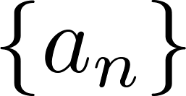
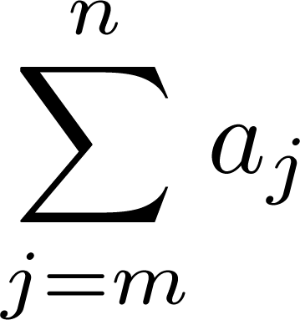
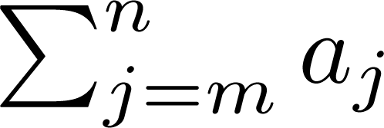
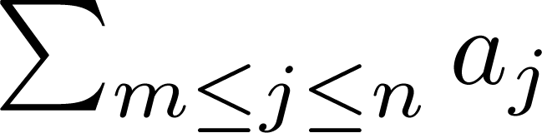
Sequences and Summations
Summations
Sum of the terms
from the sequence
The notation:
represents
The variable j is called the index of summation. It runs through all the integers starting with its lower limit m and ending with its upper limit n.
Computer Science, Purdue University

Slide 9
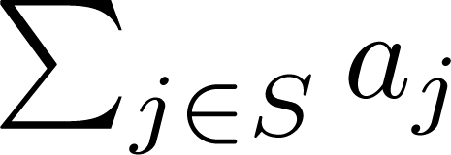
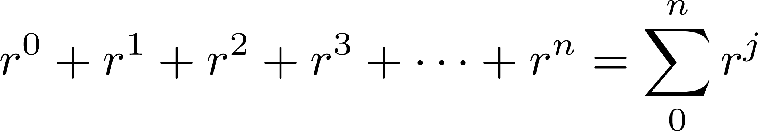
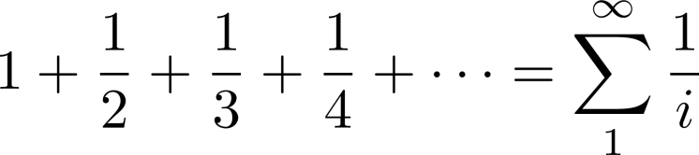
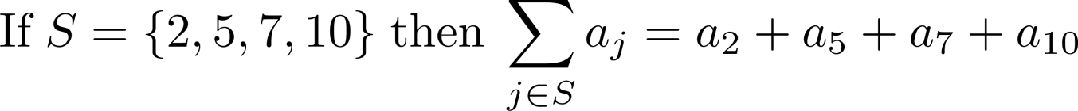
Sequences and Summations
Summations
More generally for a set S:
Examples:
Computer Science, Purdue University

Slide 10
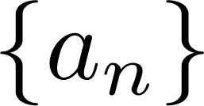
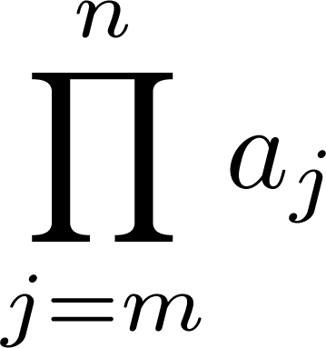
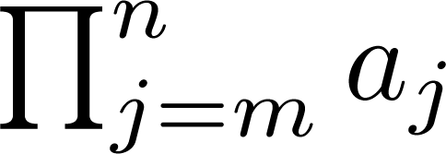
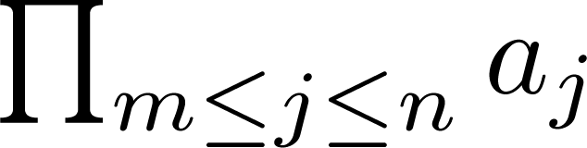
Sequences and Summations
Products
Product of the terms
from the sequence
The notation:
represents
Computer Science, Purdue University

Slide 11
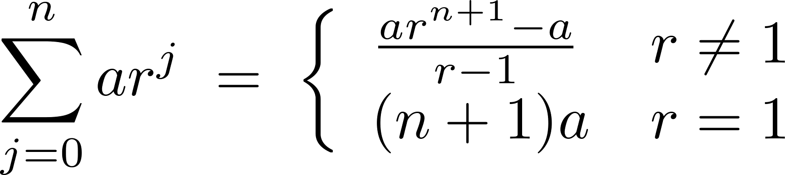
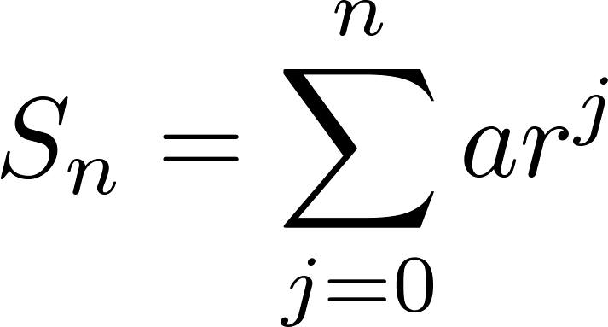
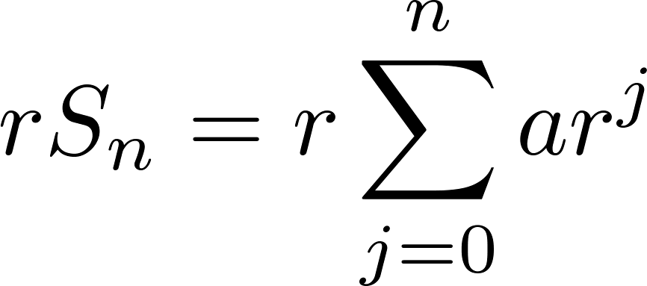
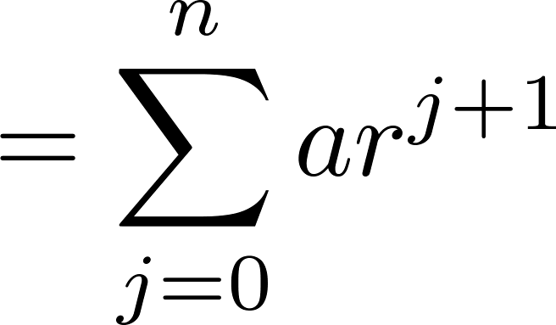
Sequences and Summations
Geometric Series
Sums of terms of geometric progressions
To compute S_{n} , first multiply both sides of the equality by r and then manipulate the resulting sum as follows:
Proof:
Let
Computer Science, Purdue University

Slide 12
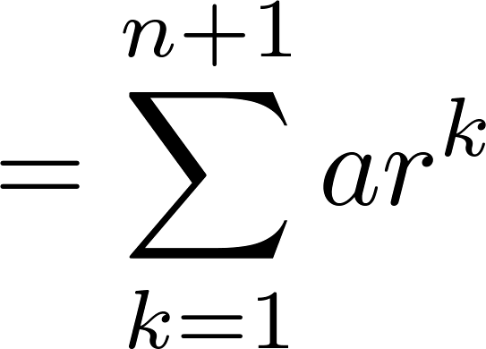
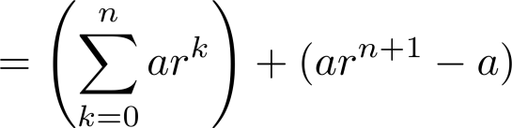
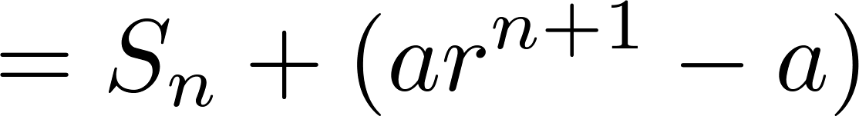
Sequences and Summations
Geometric Series
From previous slide.
Shifting the index of summation with k = j + 1.
Removing k = n + 1 term and
adding k = 0 term.
Substituting S for summation formula
Computer Science, Purdue University

Slide 13
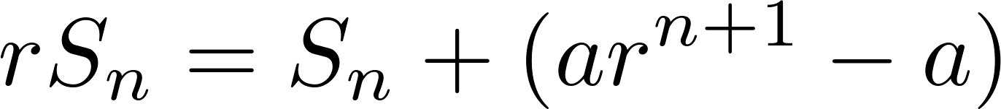
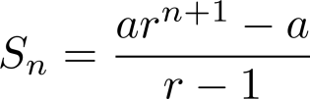
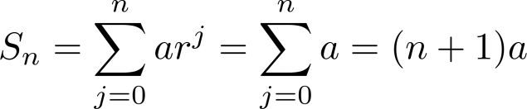
Sequences and Summations
Geometric Series
∴
if r ≠1
if r = 1
Computer Science, Purdue University

Slide 14
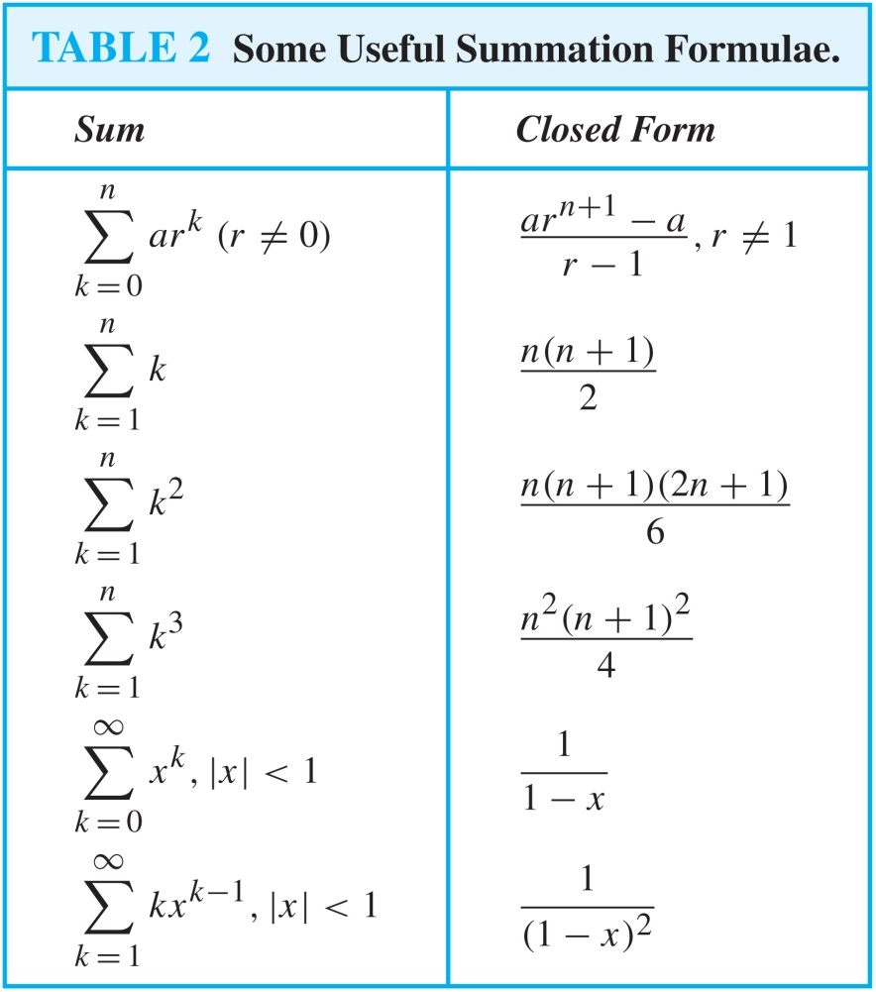
Sequences and Summations
Useful Summations
Computer Science, Purdue University

Slide 15
Thank You

